Slide 1




Final Project
Introduction to Data Science
Volcano Eruptions
Made by:
Karin Shulman Goren – 206056905
Idan Marzouk – 208711028

Slide 2
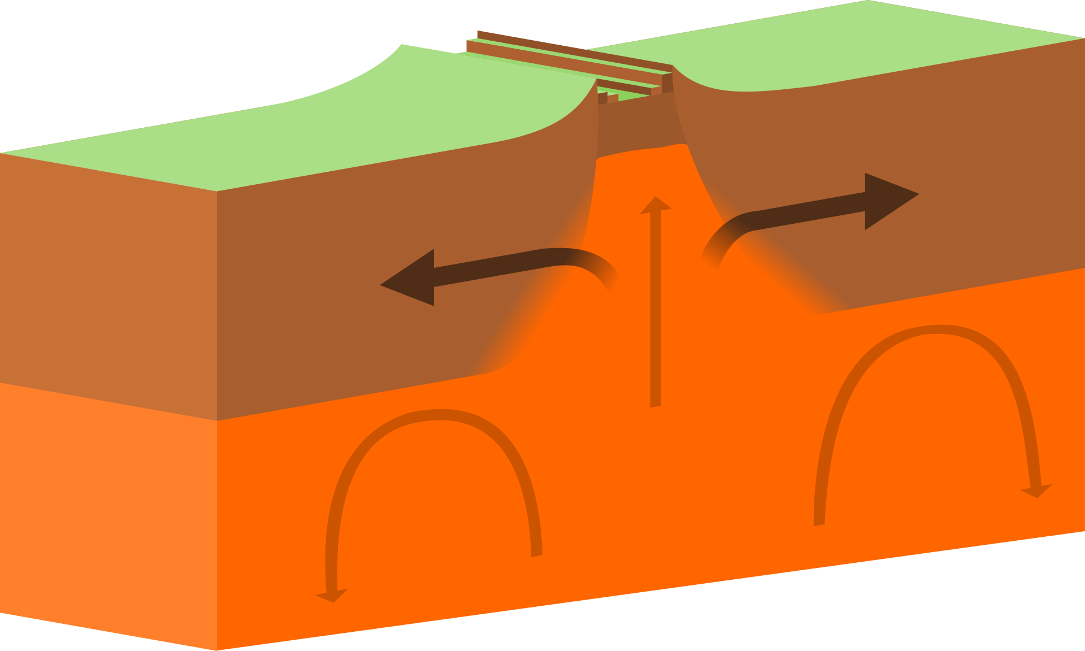
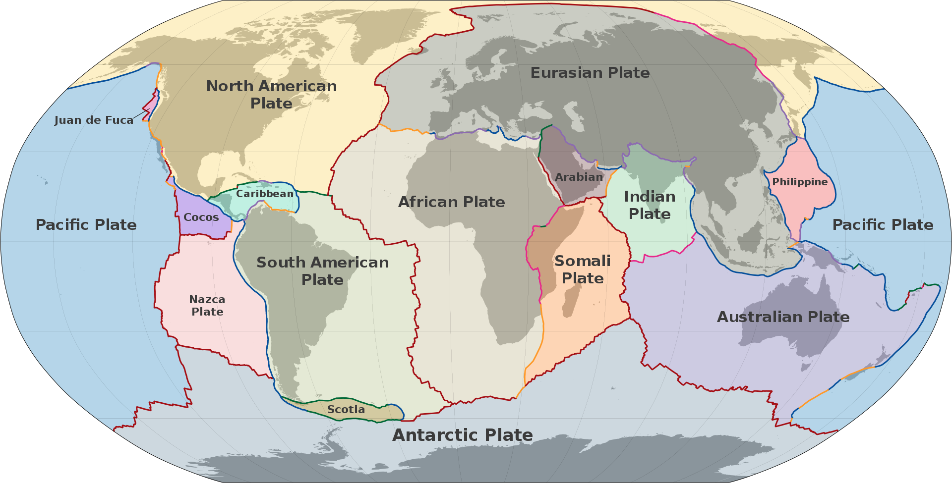

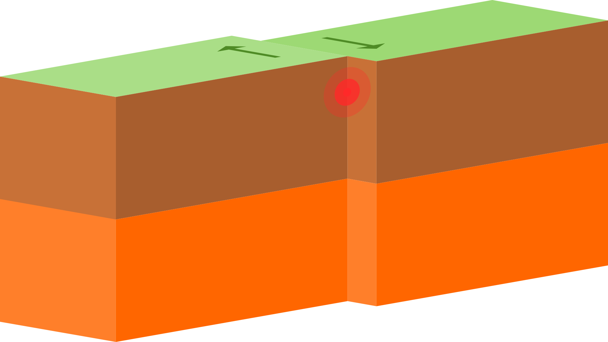
Volcanic eruptions are one of nature's phenomenon, so powerful and unique, sadly throughout the history, taken a great amount of people lives.
Many of them could be saved, only if we can predict when they happen, and how strong they will be.
Plate tectonics

Slide 3
Volcano VEI level volcanic explosion index
Mega-colossal
8
7
Super-colossal
> 1,000 km³
> 100 km³
6
Colossal
5
Paroxysmal
> 10 km³
> 1 km³
Cataclysmic
4
3
Severe
> 0.1 km³
> 10,000,000 m³
Explosive
2
1
Gentle
> 1,000,000 m³
> 1,000 m³
Effusive
0
< 1,000 m³

Slide 4
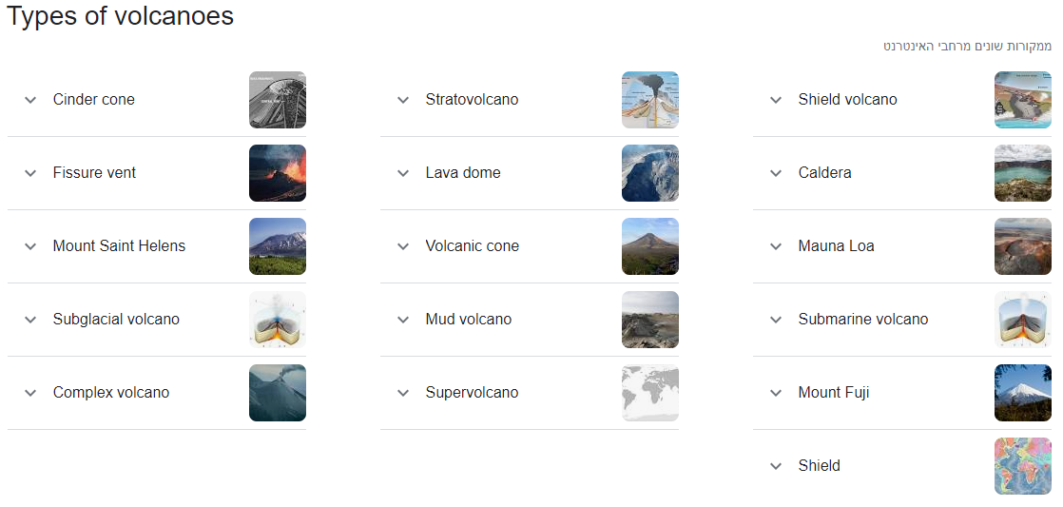
Types of volcanoes

Slide 5
Research question:
Is it possible to predict the numerical value of the "VEI“ level
of the next eruption for each active volcano
may be predicted based on "Global Volcanism Program" data?

Slide 6

Data science main steps
1
Research assumption
Data acquisition
Model deployment
Data cleaning
Exploratory Data Analysis
Model building
2
3
4
5
6

Slide 7

Data acquisition
Crawling

Slide 8
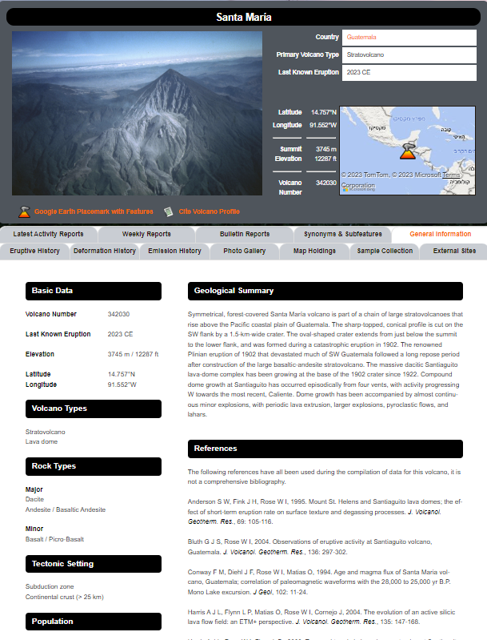
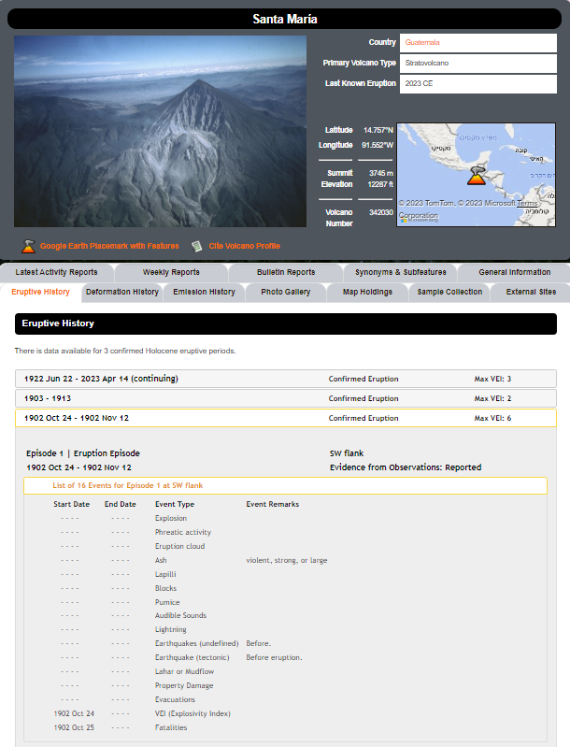
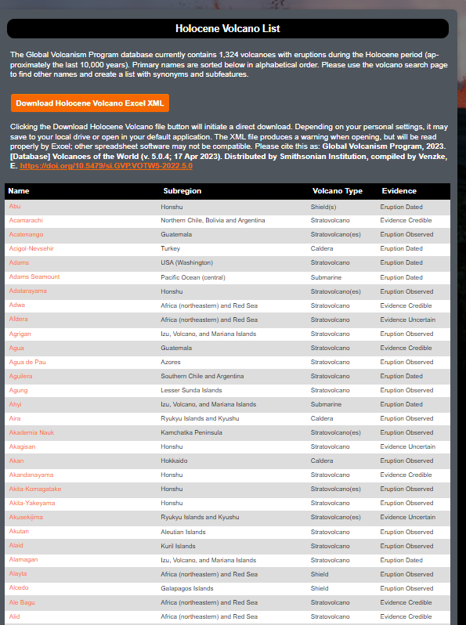

Data acquisition
Crawling:
We performed crawling on a website
Found a list of active volcanoes
Clicked on each volcano to collect the desired data
Gathered general information and eruption history
eruption list required additional clicks for detailed information
Features:
Volcano name
Volcano number
Volcano country
Volcano region
Volcano type
Latitude
Longitude
Summit elevation
VEI
Start date
Currently erupting? (Y/N)
Eruption status
https://volcano.si.edu/

Slide 9
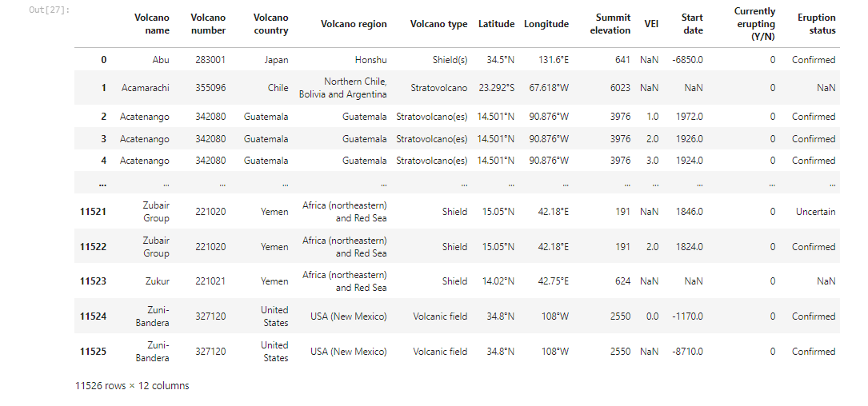
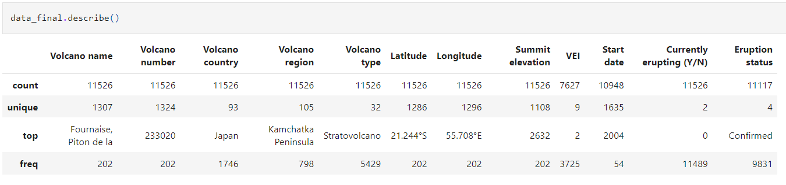
The received data frame

Slide 10
Data cleaning

Slide 11
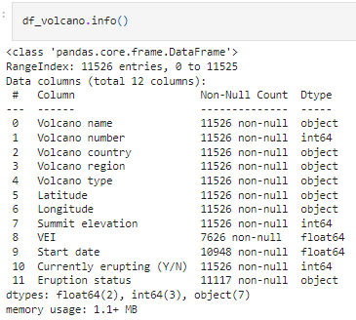
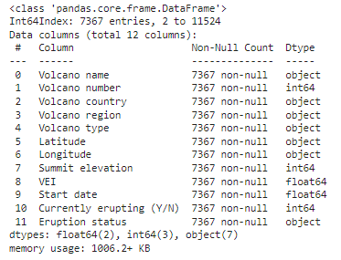
Data cleaning
In order to improve the accuracy of our analysis, we performed comprehensive data cleaning by addressing issues such as missing, duplicate, and problematic values.
To make the eruption data more user-friendly and span centuries, we transformed the start date column to only display the year, eliminating the need for specific dates.
Additionally, we encountered situations where individual volcanoes had multiple sub-eruptions, which we consolidated into a single primary eruption event.
Furthermore, we eliminated columns with a high number of missing values or that were not relevant to our research objectives.
Moreover, during the data collection phase, we encountered text strings containing symbols instead of numerical values. To ensure effective progress, we converted the text into appropriate numerical values.

Slide 12
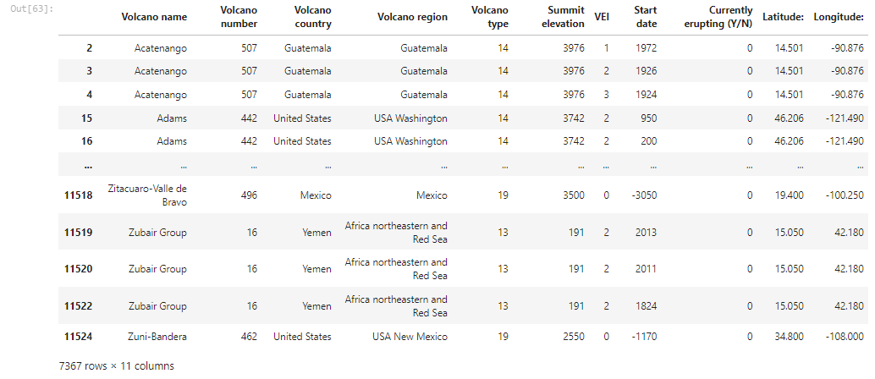
The cleaned data frame

Slide 13
EDA
Visual data analysis

Slide 14
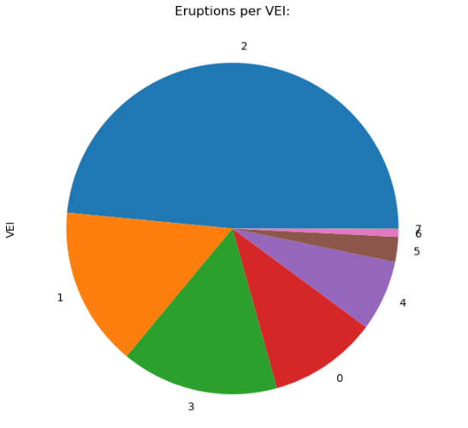
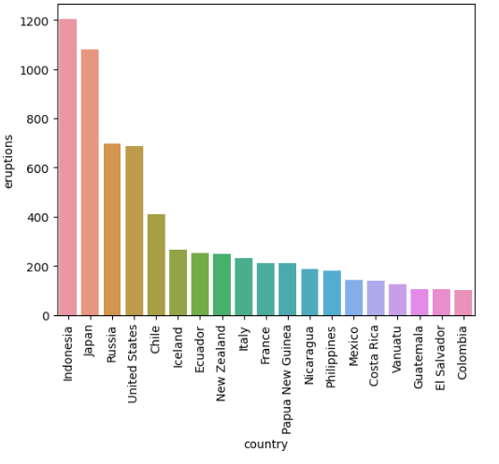
Visual data analysis
Pie chart of eruptions per VEI:
Bar plot of eruptions per country:
(only 100 or more eruptions)
We can see that most of the volcanic eruptions are in the level of 2 VEI
We can see that most of the leading countries of volcanic eruptions are around the Pacific Plate tectonic plate that known as the "Pacific Ring of Fire"

Slide 15
Pacific Ring of Fire

Slide 16

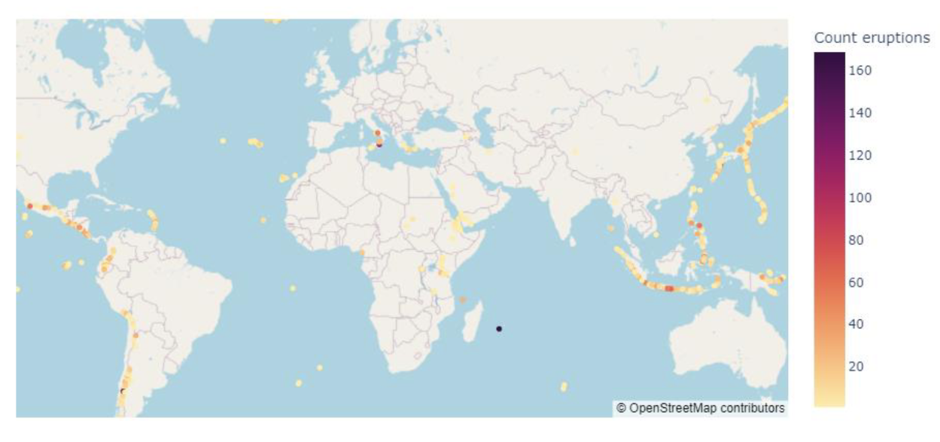
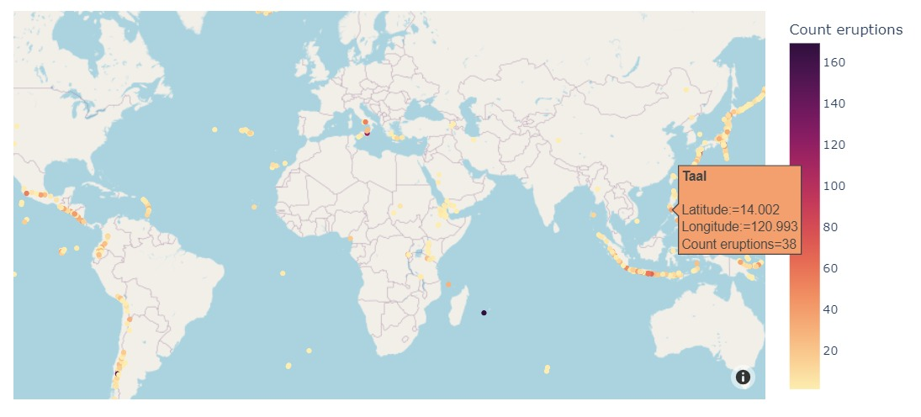
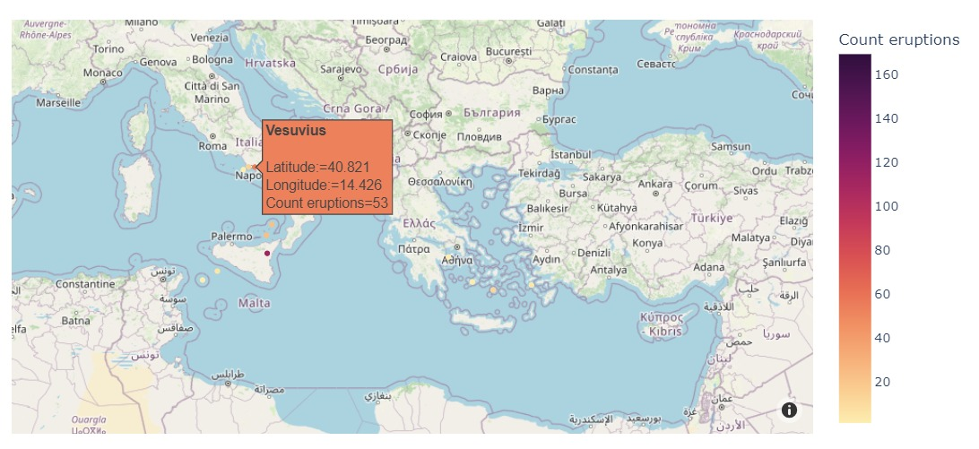
Visual data analysis
Interactive world map of volcanoes location:
This is an interactive graph that utilizes the Latitude and Longitude columns from our dataframe to display a live map of volcanoes, allowing users to zoom in and out for a more detailed view.

Slide 17
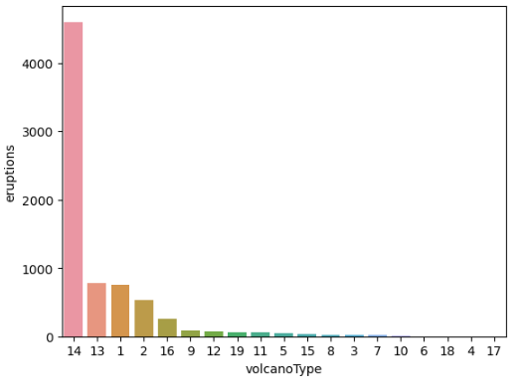
Visual data analysis
Bar plot of eruptions per volcano type:
Index | Voicano type
1 | Caldera
2 | Complex
3 | Compound
4 | Cone
5 | Crater rows
6 | Explosion crater
7 | Fissure vent
8 | Lava cone
9 | Lava dome
10 | Maar
11 | Pyroclastic cone
12 | Pyroclastic shield
13 | Shield
14 | Stratovolcano
15 | Subglacial
16 | Submarine
17 | Tuff cone
18 | Tuff ring
19 | Volcanic field
We can see that the “volcano type “Stratovolcanoes” have the biggest amount of volcanic eruptions.

Slide 18
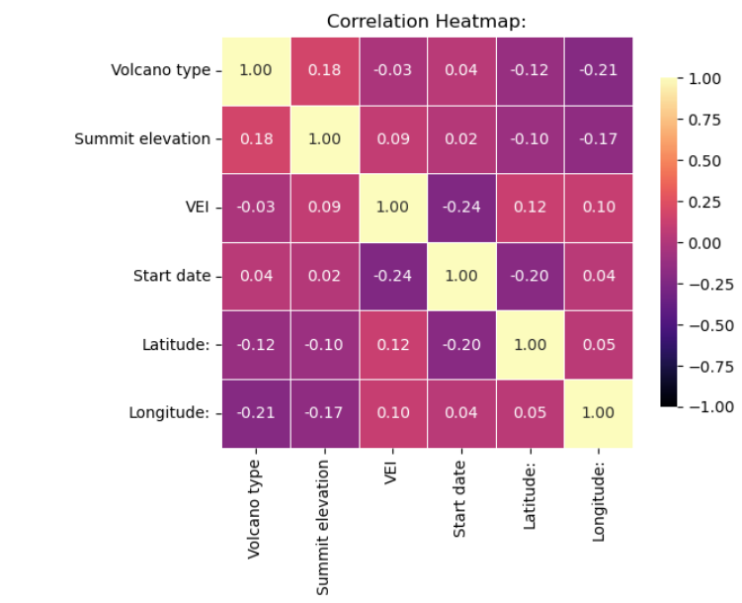
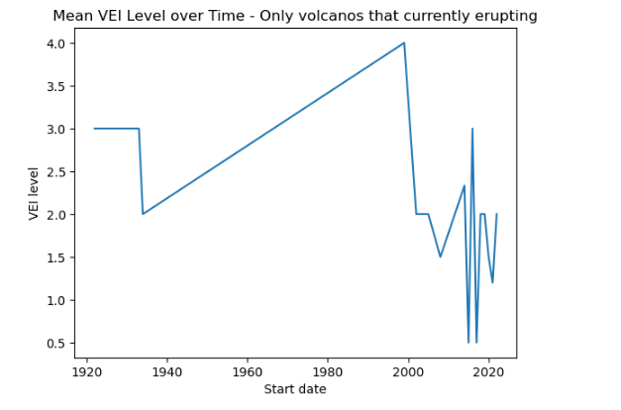
Visual data analysis
Heatmap:
Line plot:
We can see that there is a lack of significant correlation among the various features of volcanic eruptions.
The graph illustrates the average eruption intensity of all active volcanoes, revealing a notable increase in intensity around the year 2000.

Slide 19
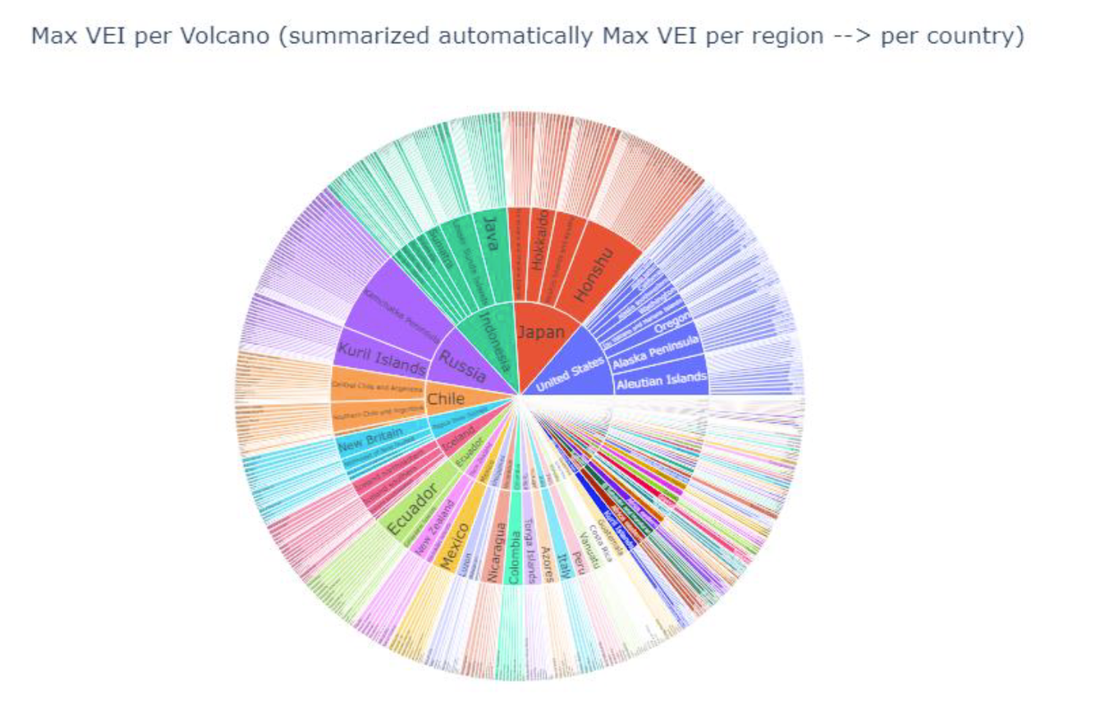
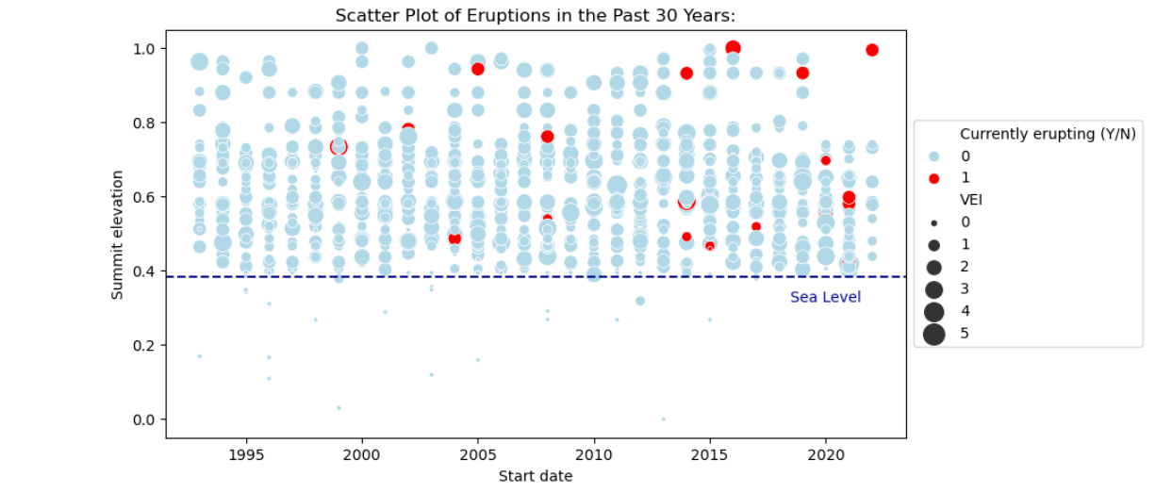
Visual data analysis
Sunburst chart using the Plotly library:
Scatter plot, 4 features using marker style:
The graph presents a hierarchical representation of the largest recorded of eruption VEI for each volcano, providing a comprehensive overview of different volcanoes and showcasing segment sizes categorized by regions and countries in a hierarchical order.
The graph describes 4 features related to volcanic eruptions over the past 30 years. Each dot on the graph represents an eruption, with the Y-axis indicating volcano height (normalized) and the X-axis representing years, starting from 1993. The color of each dot indicates the active status of the volcano, while the size of the dot represents the intensity of the eruption. By adding a sea level line, the graph highlights the distinctions between volcanoes that are higher than the sea level line and those that are lower than it

Slide 20
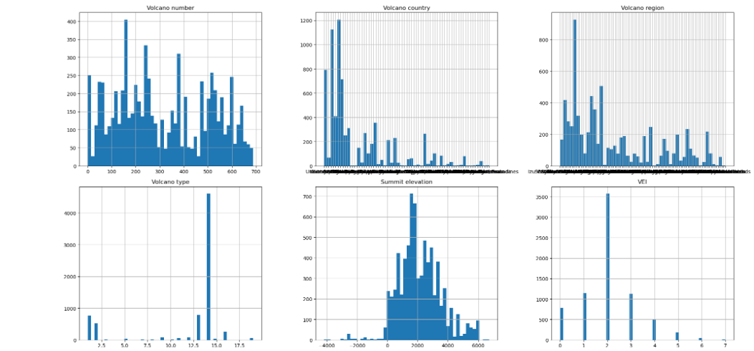
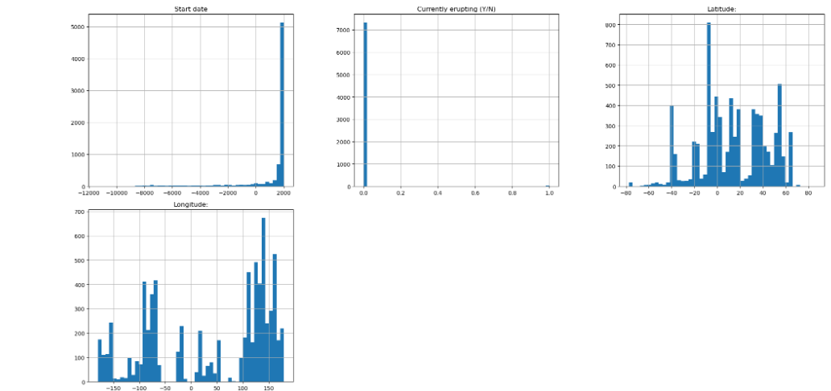
Visual data analysis
Subplots:
A lot of data can be deduced from these graphs
Each column is presented as its own histogram in relation to the number of eruptions.
By examining these histograms, one can easily identify the regions or countries where volcanic eruptions are most prevalent.
Additionally, a noteworthy observation is the substantial rise in reported eruptions over years.

Slide 21
Visual data analysis
Conclusion:
Our analysis yielded several important findings:
We discovered that some of the correlation relationships we expected were not as strong as anticipated.
we identified the geographic regions where high-intensity eruptions occur most frequently and areas with a significant number of eruptions regardless of intensity.
our research demonstrated the significant impact of volcanic regions on the magnitude of subsequent eruptions.
We have observed that volcanic eruptions typically have VEI values ranging from 0 to 5. However, it is crucial to highlight the severe consequences linked to VEI levels 6 and 7, as they present a significant hazard to human life, despite being less common.
So far, no volcanic eruption with VEI 8 has been recorded.

Slide 22
Model deployment
Machine learning

Slide 23
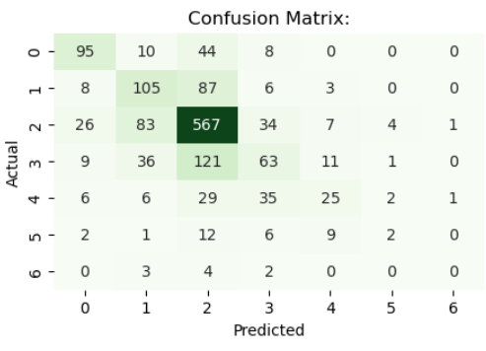
Machine learning
In this machine learning exploration, global volcano eruption data is analyzed using different classification models. The models used include:
K-Nearest Neighbors (KNN) - it predicts eruptions based on proximity, using labeled neighbors to identify patterns.
Gaussian Naive Bayes - predicts the active status of volcanoes based on the given dataset.
Multi-Layer Perceptron (MLP) - is selected for its ability to capture non-linear relationships in the data and effectively handle complex patterns.
Support Vector Machine (SVM) - fits the model to the training data and predicts the volcano statuses for the test data, aiming to determine the volcano eruption status.
Random Forest – combines multiple decision trees and is suitable for classification tasks, especially for handling complex datasets and providing accurate predictions.
Logistic Regression - is utilized to classify the eruption status of volcanoes based on the provided dataset. Performance metrics are calculated to assess the model's accuracy and effectiveness.
The evaluation of these models includes metrics such as accuracy, precision, F1 score, recall, and the results are visualized through a confusion matrix heatmap.
These evaluation metrics provide insights into the models' performance and their ability to accurately classify volcano eruption statuses.
KNN
MLP
SVM
Naive Bayes
Random Forest
Logistic Regression
Machine learning

Slide 24
Conclusion

Slide 25
Conclusion:
The research project aimed to predict the VEI level of future eruptions for active volcanoes using data from the Global Volcanism Program.
However, due to limited historical data and the recent recording of various measurements that began to be recorded mainly in the last 200 years, it was found that achieving prediction accuracy above 56-59 percent is challenging.

Slide 26
Credits
https://scikit-learn.org/stable/
https://stackoverflow.com/
https://www.geeksforgeeks.org/
https://www.redditinc.com/ocs/
https://www.google.com/
https://volcano.si.edu/
http://ete.cet.edu/
https://he.wikipedia.org/wiki/
This presentation template was created by EaTemp

Slide 27
Thank you!
We are truly grateful for the opportunity to work on our data science project centered around volcanic eruptions.
It has been a pleasure to be part of this course and learn from it.
Throughout the project, we acquired a wide range of skills and knowledge. We started with learning the basics of web crawling and understanding HTML structures, which allowed us to collect relevant data from online sources. As we progressed, we delved into the exciting task of predicting volcano eruptions, employing advanced data science techniques and models.
Working as a team on this large-scale project provided us with invaluable experience in collaboration and data handling. We became adept at managing substantial amounts of data, preprocessing it, and uncovering meaningful insights. These skills will undoubtedly benefit us in future endeavors.
Overall, this data science project has been a rewarding experience, enabling us to expand our knowledge, analyze data effectively, and work as a cohesive team. We are grateful for the opportunity to undertake this project and the valuable lessons we have learned.

Slide 28
THANK YOU!
Karin Shulman Goren – 206056905
Idan Marzouk – 208711028

